Slide 1
An Intermarket Analysis study between Treasuries and the SP500 using Machine Learning Algorithms
Student: Nikolas Lippmann Pareschi
Professor: Ritabrata Bhattacharyya
World Quant University

Slide 2

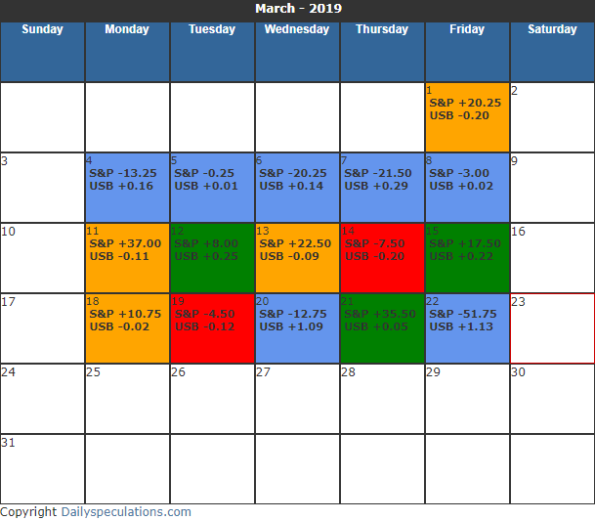
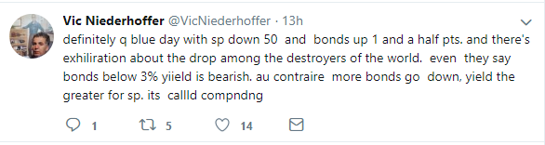

Slide 3
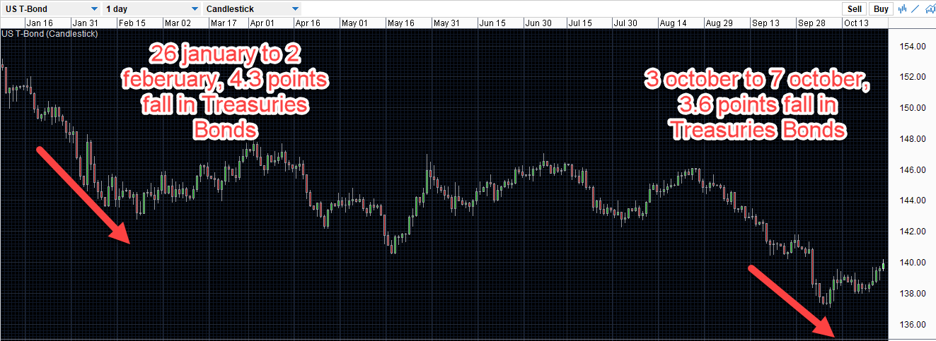
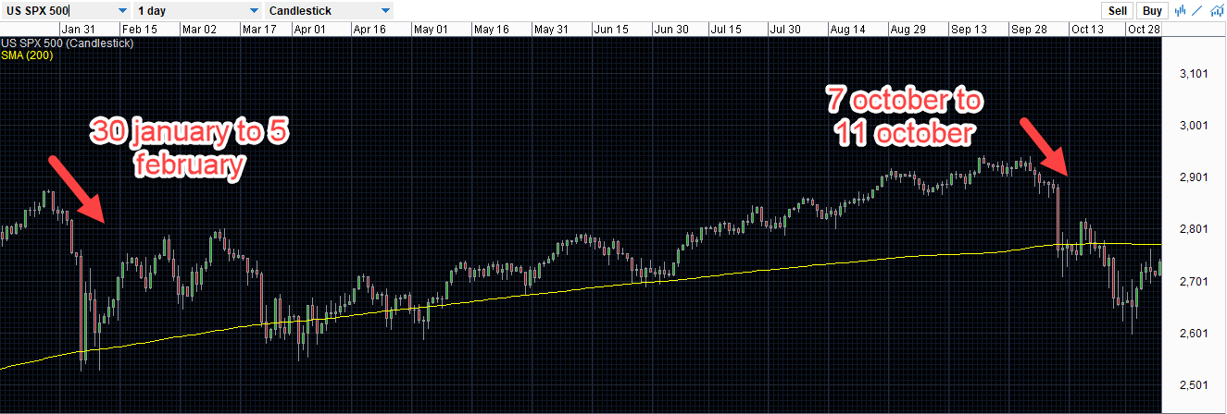
PREDICTIVE POWER OF TREASURIES OVER EQUITIES

Slide 4
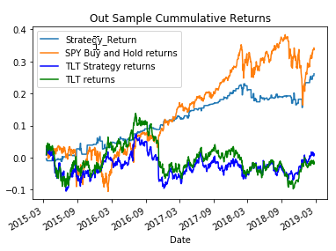
Results using only 1 predictor

Slide 5
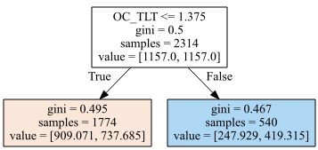
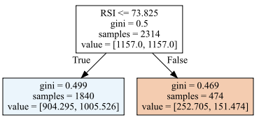
Decision Tree Classifier Results using one predictor

Slide 6


F1-Scores

Slide 7
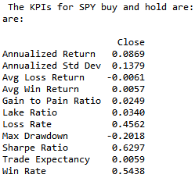
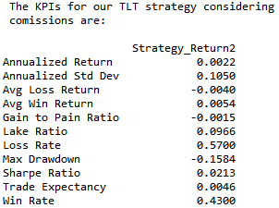
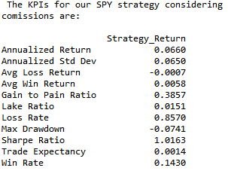
KPIs for decision tree using only one classifier

Slide 8
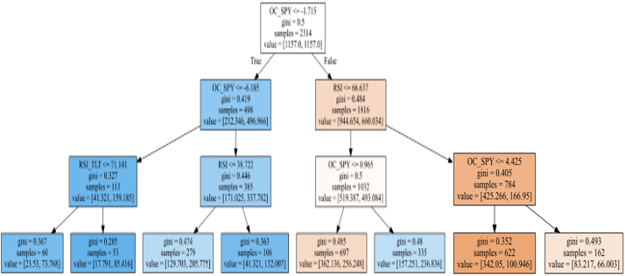
Decision Tree using 4 classifier and higher depth

Slide 9
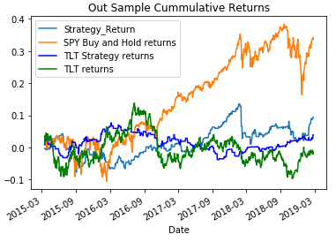

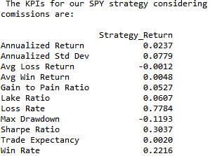
More predictors and higher depth led to overfit

Slide 10
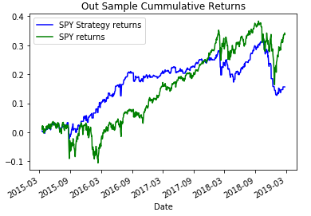
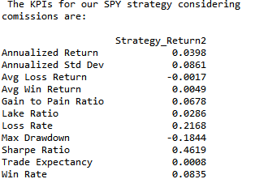
SVM algorithm trying to stay in the 50% better days of spy using one predictor:

Slide 11
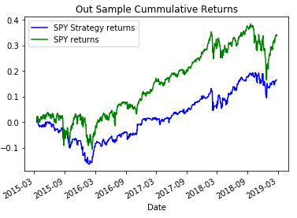
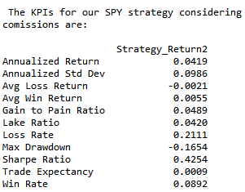
SVM trying to stay in the 50% better days on spy using 4 predictors:

Slide 12
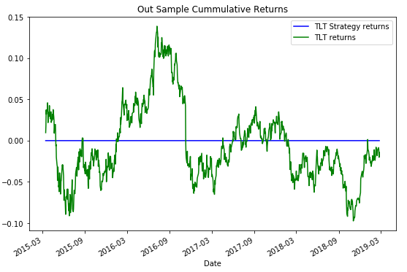
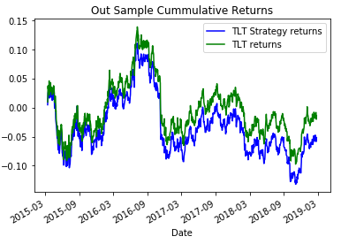
SVM trying to stay in the 50% better days on TLT using one predictor and 4 predictors:

Slide 13
S.W.O.T Analysis
Decision Tree Classifier is very sensitive to overfit. So, the results easily deteriorate if we combine other predictors. Support Vector Machine in the other hand does not achieve interesting results with few predictors.
The Machine Learning algorithms and the code developed in the project can easily be applied to test other intermarket relationships that may have predictive power, such as Dollar x Commodities, Dollar x Emerging Markets Equities, Oil x Natural Gas.
Possibly the only immutable rule in the markets is that they are always changing. It is possible that the treasuries stop having predictive power over equities in the future.
The Decision Tree Classifier improved considerably the results from the Buy and Hold for the SP500. The SP500 system has achieved high statistical significance. The project also demonstrated what the specialized literature suggests, SVM are less prone to overfit than the Decision Tree Classifiers. The relationship between Treasuries and Bunds have survived the test of time.

Slide 14
THANK YOU!!!!

